Slide 1

What You’ll Buy Next
& When You’ll Buy It
Utilizing AWS and Spark ML to Predict User Choices
Team 9: Xiyang Xu, Kitlyn (Hui-Lun) Kuo , Yanlun Ren, Raghuveer Rao Vijjini, Sydney Jiang, Wade Wimer

Slide 2
Agenda
Predictive: System Concept and Comparison to Traditional
Tools and Emergent Techniques
System Creation and Output
Business Use Cases
Conclusion

Slide 3
Agenda
Predictive: System Concept and Comparison to Traditional
Tools and Emergent Techniques
System Creation and Output
Business Use Cases
Conclusion

Slide 4
Recommender System Concept

Slide 5
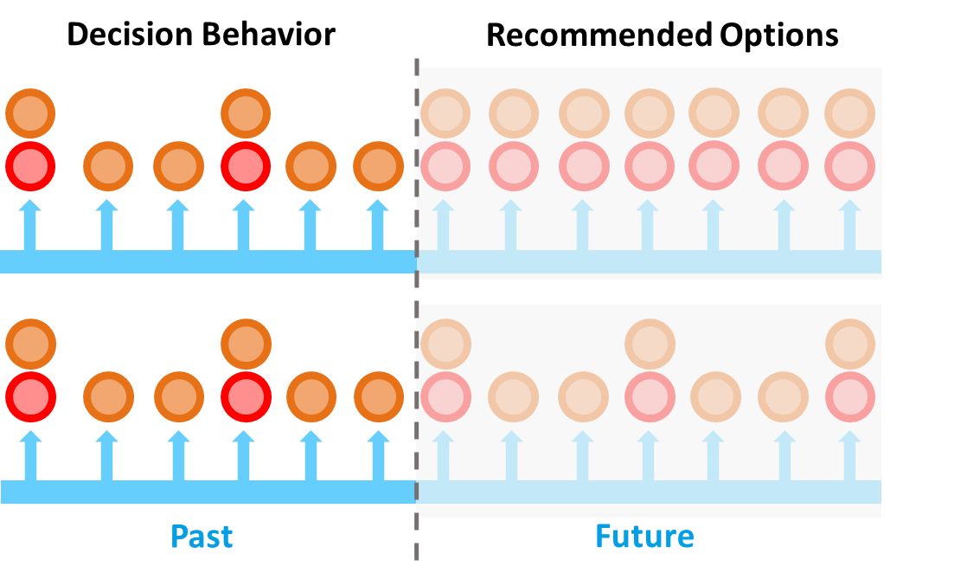
Comparison to Traditional Systems
Traditional Systems:
Suggest products that customers want, but do not address when they may want them.
“Predictive” System:
Sophisticated models introduce time as a predictive factor, providing helpful reminders, not ads

Slide 6
Agenda
Predictive: System Concept and Comparison to Traditional
Tools and Emergent Techniques
System Creation and Output
Business Use Cases
Conclusion
Notes:
Next, we’re gonna talk about the big data techniques we used

Slide 7






Tools and Emergent Techniques
Recommender systems use large amounts of proprietary data gathered for several years
S3 provides:
Unlimited Storage
Immediate Access
Security
Recommender systems require robust computational strength to manipulate high volume data with complex algorithms
Amazon EMR‘s computing structure is streamlined for big data capabilities
Modern Recommender systems are complex and intentional algorithms with many stages
Spark ML’s algorithms interface with big data applications and allow for recommender system creation for free with with few key strokes
Notes:
We use three big data tools to manage our large datasets. First, the amazon s3 provided us with large & secure storage space. Second, Amazon EMR allowed us to manage high volumn data in clusters, which is much more efficient than working on python. Lastly, the spark Mllib provides greater scale and is easy to apply our machine learning models using random forest

Slide 8
Agenda
Predictive: System Concept and Comparison to Traditional
Tools and Emergent Techniques
System Creation and Output
Business Use Cases
Conclusion

Slide 9
System Creation
Input Data
Model Building
Output Translation
Feature Engineering

Slide 10
System Creation: Input Data
User ID
Transaction Time
Product
Minimum attributes needed to inform model
Amt Purchased
Last Visit Time
Item Location
Added in this data set to inform user access
Input Data
Model Building
Output Translation
Feature Engineering
Input Data
Model Building
Output Translation
Feature Engineering

Slide 11
System Creation: Feature Engineering
Input Data
Feature Engineering
Developed Sections
User Features
6 Features
Item Features
9 Features
User x Item Features
7 Features
Datetime Features
2 Features
Input Data
Model Building
Output Translation
Feature Engineering
Input Data
Model Building
Output Translation
Feature Engineering

Slide 12
System Creation: Model Building
Random Forest Algorithm
Good performance
50 tree nodes running parallel
across Spark clusters
Input Data
Model Building
Output Translation
Feature Engineering
Input Data
Model Building
Output Translation
Feature Engineering

Slide 13
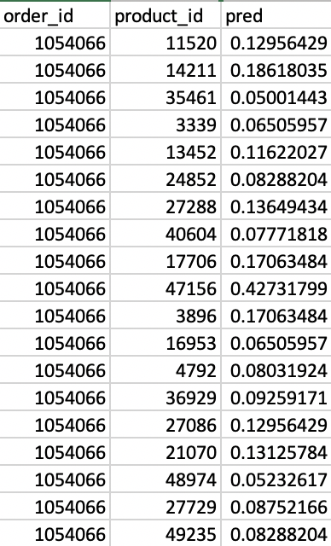
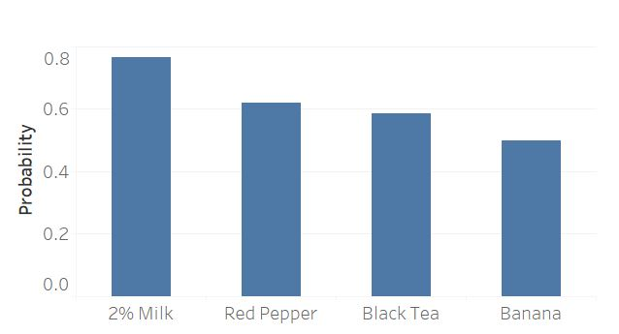
System Creation: Output Translation
probabilities of a specific user buying specific product at a specific time
Input Data
Model Building
Output Translation
Feature Engineering
Input Data
Model Building
Output Translation
Feature Engineering

Slide 14



c
Data Example
User: Sydney
Healthy purchases on Monday afternoon
Snacks on Weekend nights
Monday Afternoon Basket
Sunday Evening Basket
While wheat bread
Tomatoes
Coconut Milk
Lemon Juice
Chocolate nuts
Chocolate Mint Ice Cream
Tortilla Chips
Case Sugar

Slide 15
Agenda
Predictive: System Concept and Comparison to Traditional
Tools and Emergent Techniques
System Creation and Output
Business Use Cases
Conclusion

Slide 16
E-Commerce Use Case
User: Kitlyn
Browse app weekly at 8pm
Prefer healthy products
Purchased Item
User x Item Features
Recommender System:
Toothpaste
Repurchase frequency: monthly
90% repurchase rate
30 days since last toothpaste order
Co-purchase with mouthwash
Recommend toothpaste and mouthwash a month from her last purchase.

Slide 17
Financial Service App Use Case
User: Wade
Trades stock once per week
Browses app daily 6pm
Prefers tech
Purchased Item
User x Item features
Recommender System:
APPL stock
High growth potential
Technology sector
Repurchase stock in 10 days
30% of user’s portfolio
Recommend purchase MSFT in 10 days from repurchase AAPL stock.

Slide 18




Other Use Case Examples
Healthcare
Diet
Drugs
Checkups
Taxi / Rideshare
Driver Insights
Consumer Reminders
Car Maintenance
Smartphones
Notifications
News
Online Videos
Apps/Websites
Shipping / Logistics
Regular Shipments
Scheduling and Directions
Notes:
Yong Ge; Hui Xiong; Alexander Tuzhilin; Keli Xiao; Marco Gruteser; Michael J. Pazzani (2010). An Energy-Efficient Mobile Recommender System (PDF). Proceedings of the 16th ACM SIGKDD Int'l Conf. on Knowledge Discovery and Data Mining. New York City, New York: ACM. pp. 899–908. Retrieved 2011-11-17.

Slide 19
Agenda
Predictive: System Concept and Comparison to Traditional
Tools and Emergent Techniques
System Creation and Output
Business Use Cases
Conclusion

Slide 20
Conclusion
Approaching a recommendation problem as a predicative problem
Leveraging Spark on AWS enables business to scale up only when training a model

Slide 21
Thank You
Team 9: Xiyang Xu, Kitlyn (Hui-Lun) Kuo , Yanlun Ren, Raghuveer Rao Vijjini, Sydney Jiang, Wade Wimer

